Slide 1
NLP CLASSIFICATION & SENTIMENT ANALYSIS FOR Bacchanal Buffet
Introduction
Methodology
Results
Conclusions
Future Work

Slide 2
INTRODUCTION
Business Need | Improving services and customers satisfy for Bacchanal Buffet.
Solution | Using Yelp and Twitter data, Analyse Reviews, Customer’s Sentiment and provide suggestions.
Objectives | NLP Supervised Classification on Yelp Dataset Sentiment Analysis on Yelp Dataset Scraping Twitter Dataset and Building Sentiment Analysis Compare Results

Slide 3
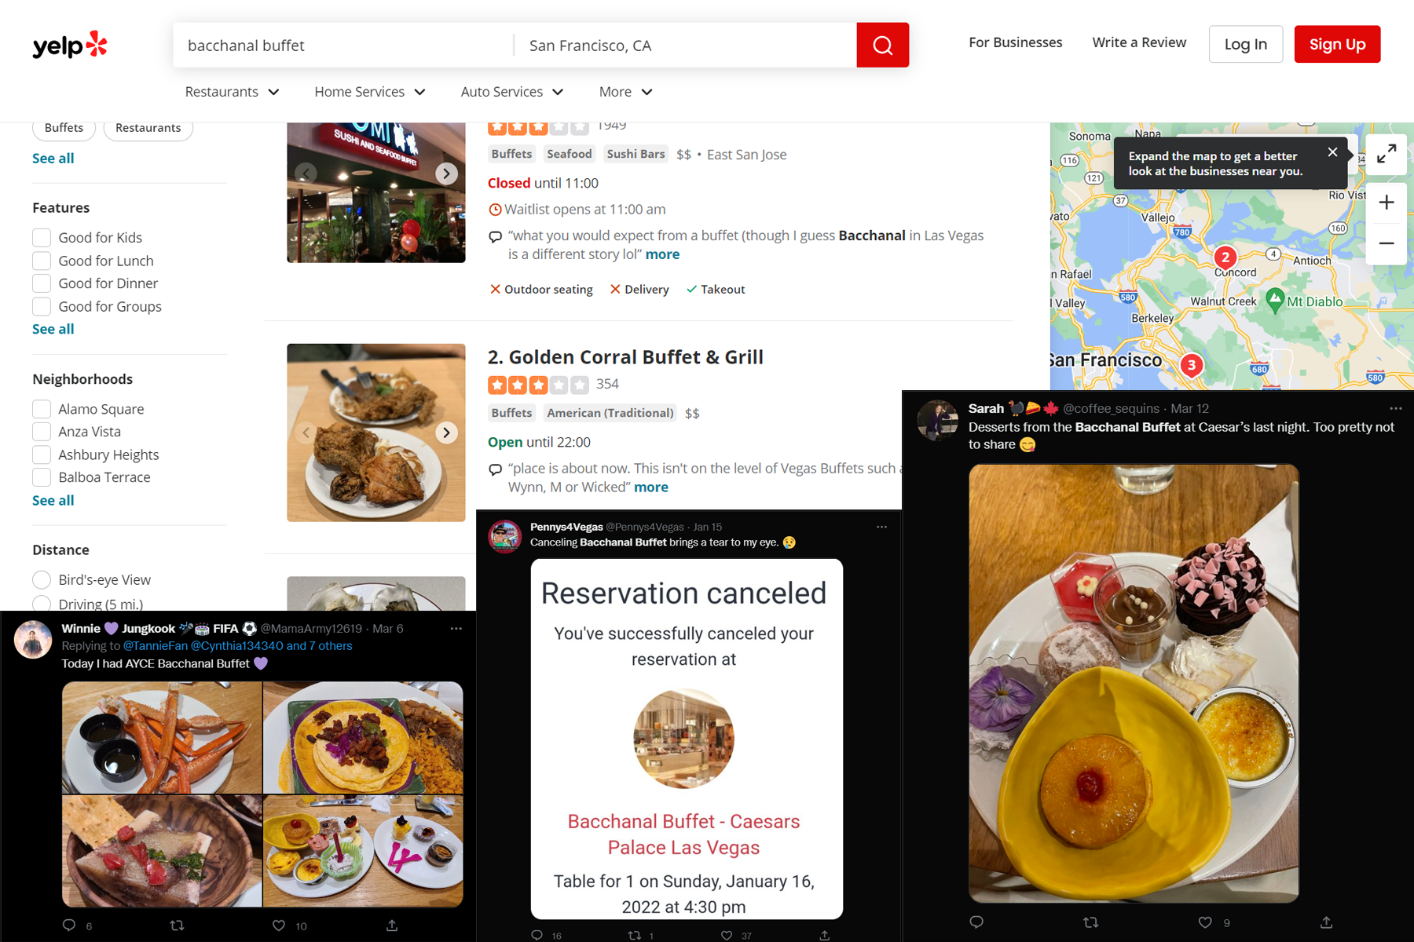

Slide 4

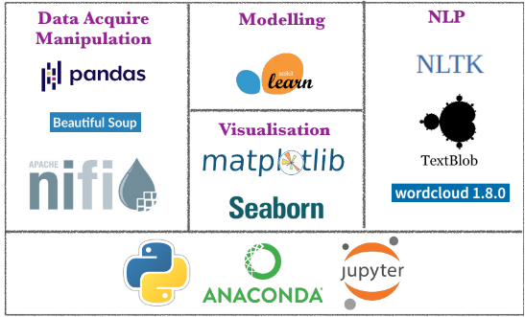

DATA SOURCES
10417 rows data
Web Scraping Twitter
TOOLS

Slide 5
Data Acquire
Exploratory Data Analysis
Text Processing
Modelling
Evaluation

Slide 6
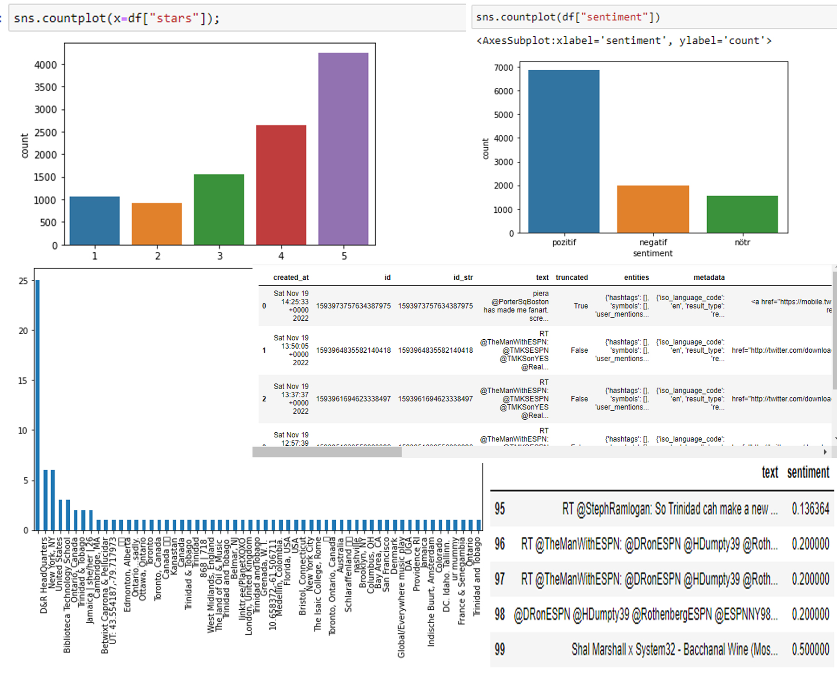

Slide 7
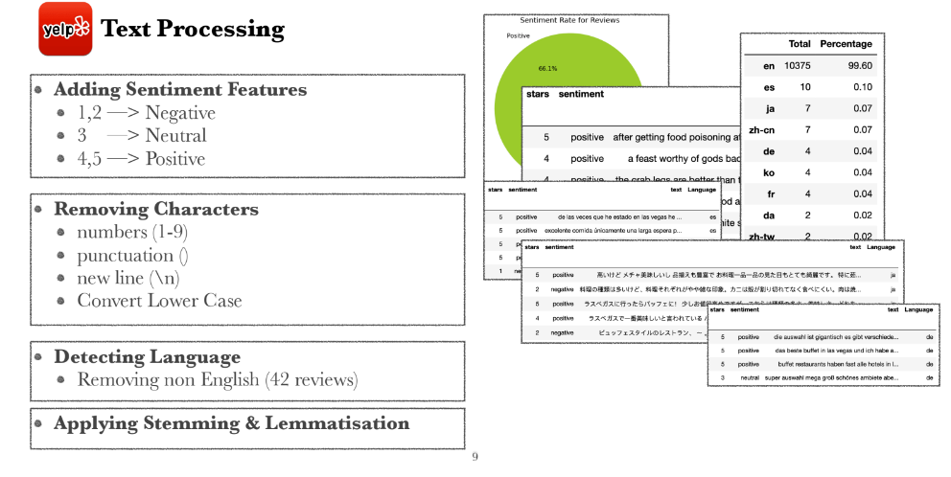

Slide 8
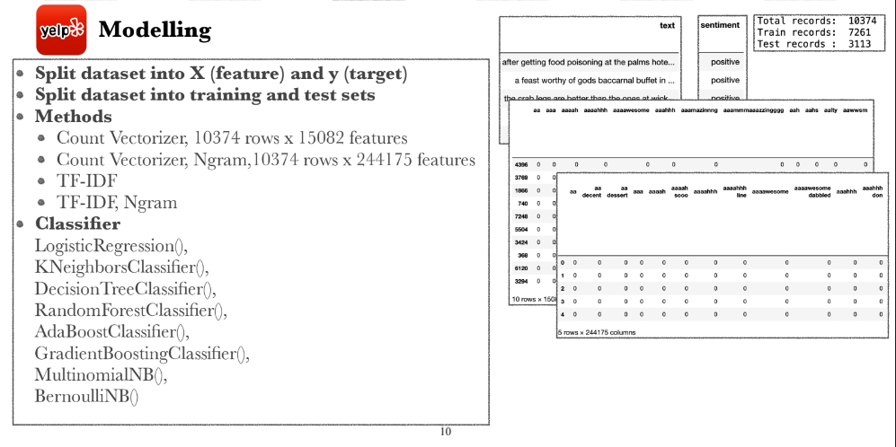

Slide 9
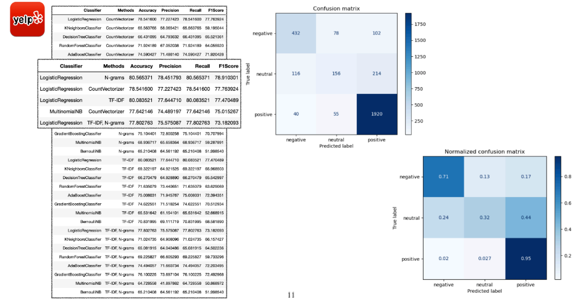

Slide 10
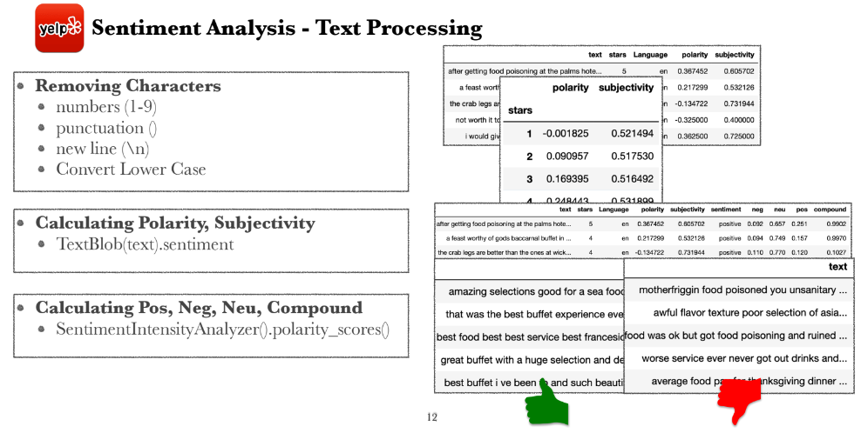

Slide 11
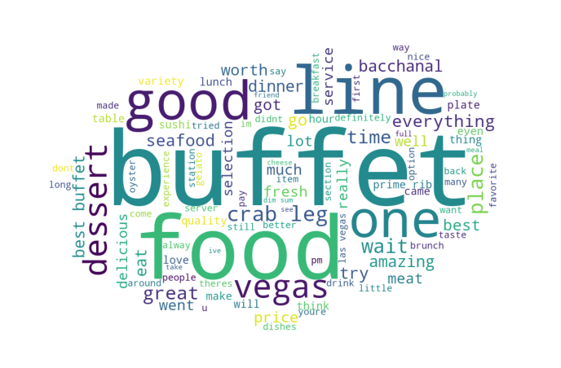
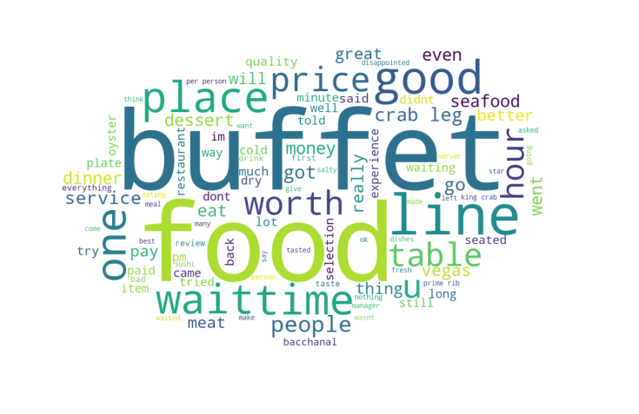
WorldCloud (Pozitive) | WorldCloud (Negative)

Slide 12
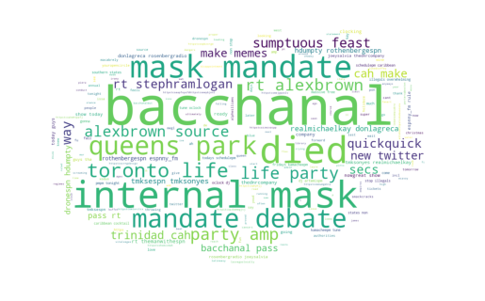
Twitter Data WorldCloud

Slide 13
